Slide 1
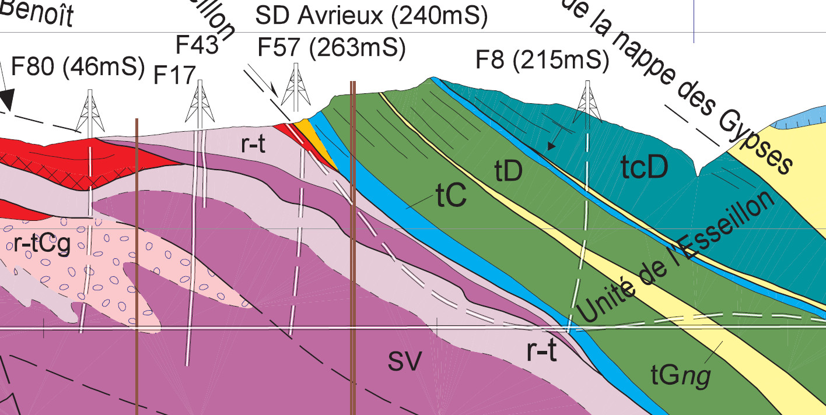




Geotechnical Data Standardization Workshop
Maison de la Géologie, Paris
January 22 – 24, 2019
hosted by

Slide 2
Providing relevant geotechnical data information (from geotechnical engineering to civil engineering)
Geotechnical engineers combine and package environmental data in order to offer civil engineers information about the construction site and the sustainable integration of the construction. This round table aims at defining the exchange requirements and current practices to fulfill that use case.
Introduction talk : Christophe Castaing (MINnD).
What can we do with geotechnical models?
Tools and algorithms that produce geotechnical data and models.
Tools and algorithms that consume geotechnical models.
Required data from those tools and algorithms.
The state of tools / editors, Commitment of editors to implement standards and functionalities in their software.
Civil engineers, geo-engineers from building companies to define what they want.

Slide 3
Geotechnical data as part of city modeling
Smart Cities are in demand of integrated city models, yet the availability of qualitative and reusable data is an issue. Data collected by geotechnical engineers can actively contribute to facilitate city modeling and this round table session aims at defining the modality to facilitate their integration.
Introduction talk : Scott Simmons - Josh Liebermann (MUDDI).
How can BIM for geotechnics help Smart Cities development?
Maintenance of geotechnical data. How to make it sustainable?
Geotechnical model update. Science or fiction?
Geological surveys, cities stakeholders, industry to define a politics for sustainable data management.

Slide 4
Working together: soul and body
Based on previous session results, this session aims at defining the “soul of the collaboration”. It will setup a collaborative framework (bSI and OGC), identify the priorities, propose the actions, discuss the important milestones and the actors to endorse it. The “body” or detailed roadmap will then be defined the third day by a smaller group.

Slide 5
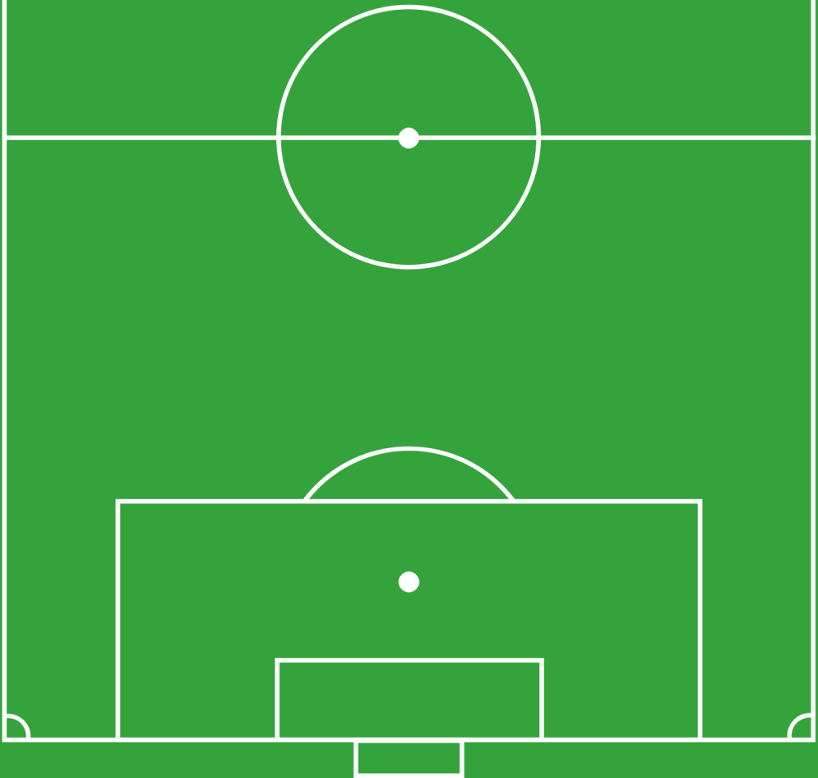
Geotechnical Data Standardization Perimeter (as introduced by MINnD UC8-GT)
Designation | Id
Structure sizing and definition of the geotechnical influence zone | CALC
Construction methods | MECO
Geological modeling | GEOL
Hydrogeological modeling | HYDR
Geotechnical modeling | GTCH
Anthropic environment modeling | AVOI
Excavations and Site Pollution modeling | TESP
Observations and Measurements | RECO
Risk and uncertainty assessment | RISK
MECO
CALC
Book C:
Draft
conception
Plan
GTCH
TESP
AVOI
Book B:
Environment
Modeling
(including RISK)
GEOL
HYDR
RECO
Book A:
Factual data
collection
RISK

